Slide 1
Understanding Convolution Neural Network
- Pramod Divakarmurthy

Slide 2
Traditional Neural Network
Vs
Convolution Neural Network

Slide 3
CNN And Layers

Slide 4


1. Input Layer - An Image is a matrix of pixel values
GrayScale
RGB

Slide 5

2. Convolution Layer — Convolution
*
=
Kernel/Filter (K)

Slide 6

Convolution Operation on a MxNx3 image matrix with a 3x3x3 Kernel

Slide 7


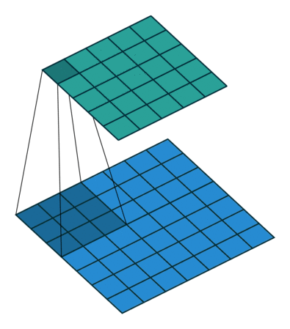
Padding
Pixels in the middle are used more often than pixels on corners and edges
Information on the borders of images are not preserved
Full Padding
Same Padding
Valid Padding
Output size
==
(m+k-1) * (m+k-1)
Output size
==
Image size
Output size
==
(m-k+1)* (m-k+1)

Slide 8

Stride
The number of pixels by which we slide our filter matrix over the input matrix
Having a larger stride will produce smaller feature maps.
Stride Length = 1 (Default)
Stride Length = 2

Slide 9
Size of Activation Map
There is a formula which is used in determining the dimension of the activation maps:
(N + 2P — F)/ S + 1
where
N = Dimension of image (input) file
P = Padding
F = Dimension of filter
S = Stride
Activation Map Size = (32 + 0 - 5)/1 + 1
= 28

Slide 10
Activation Function

Slide 11
Stacking Convolution Layers
ConvNet is a sequence of convolutional layer, interspersed with activation function

Slide 12

3. Pooling Layer
To progressively reduce the spatial size (downsampling) of the Convolved Feature
Reduces the number of parameters and computational power
Extracting dominant features which are rotational and positional invariant

Slide 13
4. Fully Connected Layer (FC Layer)

Slide 14
CNN Sequence To Classify Handwritten Digits

Slide 15
Visualizing Filters & Feature Maps

Slide 16
Popular Architectures

